Slide 1

REVIEW-03
GROUP 2 – ONLINE BANKING SYSTEM

Slide 2
CONTENT
INTRODUCTION
PROBLEM DEFINITION
AIM
FUNCTONALITIES
MODULES
SCHEMA
ER DIAGRAM
ENHANCED ER DIAGRAM
NORMALISATION
TABLE CREATION AND INSERTION OF RECORDS
USER INTERFACE DESIGN
CONNECTIVITY
CONCLUSION

Slide 3
INTRODUCTION
"Online Banking System" is a main and important thing in our day-to-day life. In the past review, we made an abstract, Schema diagram, and ER diagram. Creating an interface for online banking involves data needs. In this Review 2, we made a normalized relationship between the tables up to 3.5 normal forms, thus coming up with twenty finalized tables with sample data in it and a sample user interface design that reflects our fair website.
And now, in this review we aim to present a demo after including the connectivity between the front and the back ends.

Slide 4
PROBLEM DEFINITION
With banks being just a few clicks away; online banking allows customers to access their bank accounts from anywhere; 24/7 securely and conveniently. A new age online banking system allows customers to conduct day-to-day money transfers, direct deposits, bill payments to be carried out efficiently with utmost ease and comfort. With the concept of banking turning online, the users can keep a good eye, monitoring all their balance and pending transactions in real-time. In order to deal with the banking tasks online, a database to record all the details is very much needed along with a user interface for both the ends to interact.
This platform is designed to serve as a one-stop solution for both the customers and administrators.

Slide 5
AIM
The main aim of this project is to design and develop a database for the bank to maintain records of various branches of the bank across the country, administrators’ details as well customers' account details, account statements, transaction details, loan details (if availed by the customer) and bill payments in order to nurture the needs of an end banking user by providing various ways to perform banking tasks online.

Slide 6
FUNCTIONALITIES
Provides with individual accounts (savings or current account or both) to customers in order to preform banking tasks online.
Provides a registration link for new customers as well as a login link for existing customers to access their accounts.
Allows customers to deposit money in their accounts.
Aids customers in transactions.
Customers are also issued with debit/credit cards.
If applied, customers are provided with loans.
Various bill payments can be dealt by the customers.
Facilitates customers to view his/her own account details, account statement and all other details regarding transactions, loans, bill payments.

Slide 7
MODULES
Interface creation for Online banking system.
Register/Log-in by customers to access their bank accounts (savings or current or both)
Maintaining records of deposition, transactions by customers and customer details.
Issuing receipts, OTP(s) and mails for transactions.
Maintaining records of administrators’ details.
Maintaining records of loans availed to customers.
Debit/Credit card services
Maintaining records of bill payments (electricity bills, water bills, municipal bills, credit/debit card bills, etc.)
Report generation

Slide 8
SCHEMA DIAGRAM

Slide 9
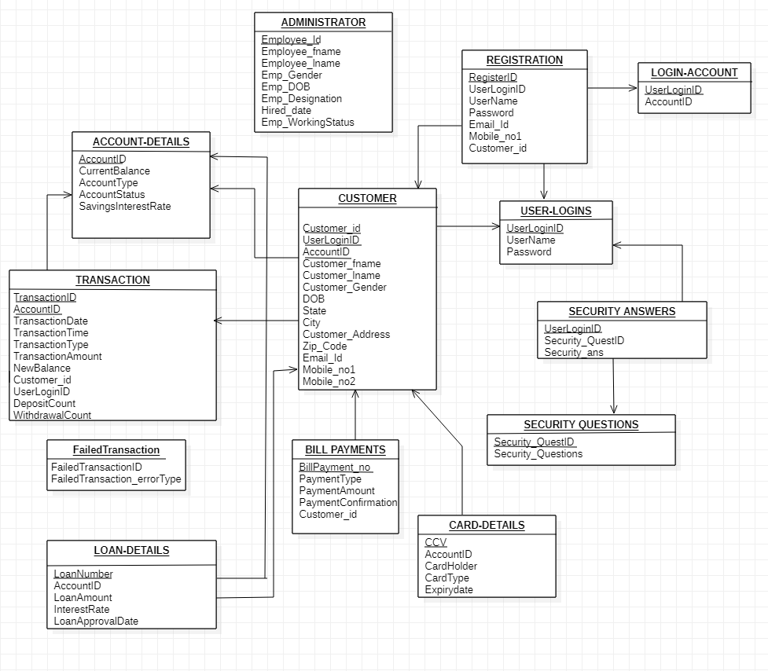
Schema Diagram

Slide 10
ER DIAGRAM

Slide 11
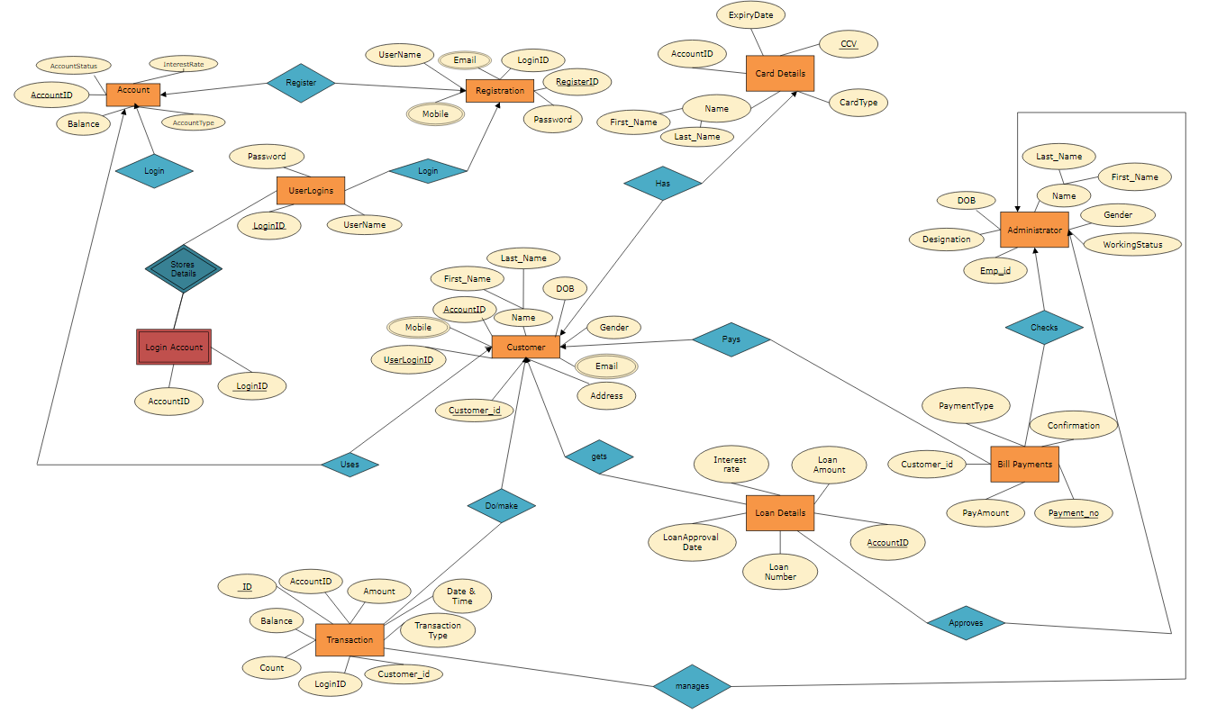
ER Diagram

Slide 12
ENHANCED ER DIAGRAM

Slide 13
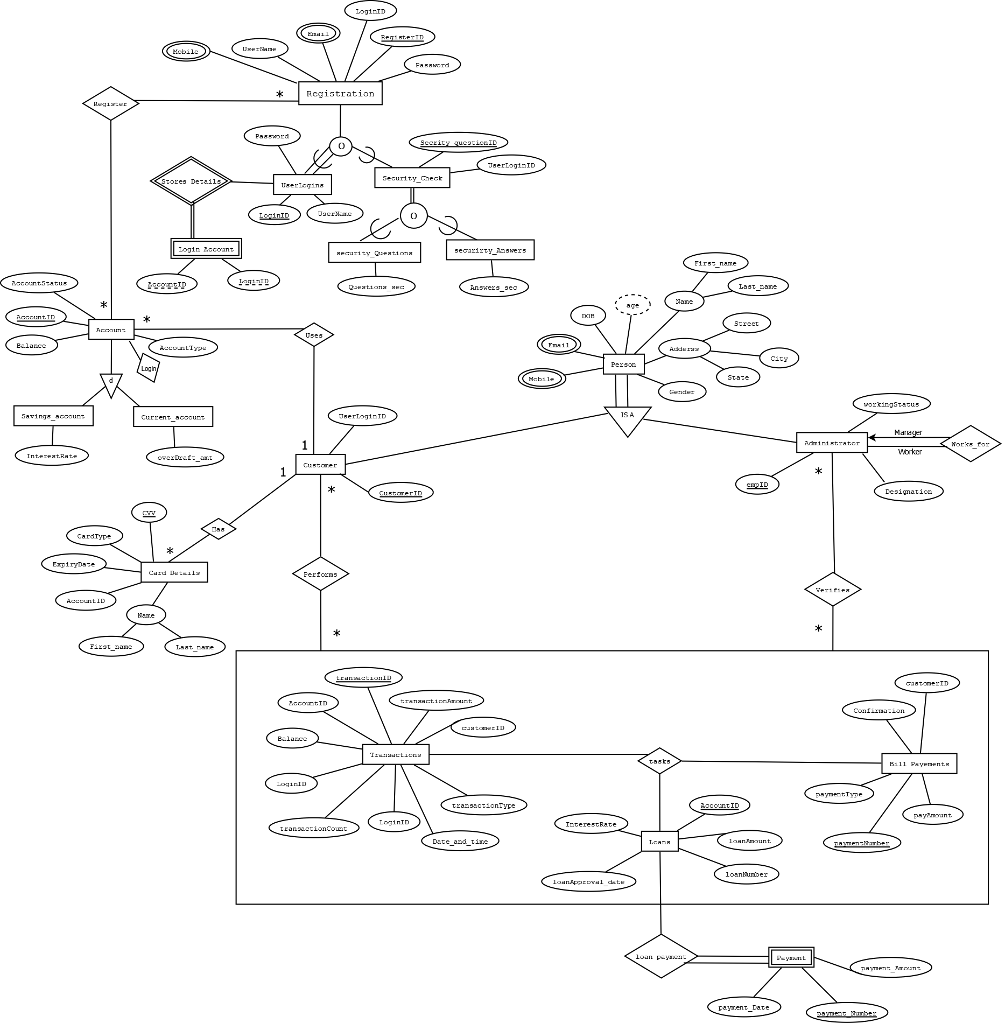
Extended ER Diagram

Slide 14
NORMALISATION

Slide 15
TABLES BEFORE NORMALISATION:
ADMINISTRATOR (Emp_id, Emp_firstName, Emp_lastName,
Emp_Gender, Emp_DOB,Emp_Designation, Emp_Designation, Hired_date, Emp_workingStatus)
CUSTOMER (Customer_id, AccountID, Customer_firstName,
Customer_lastName,Customer_Gender, DOB,
State,City, Customer_Address, Zip_code,Email_Id,
Mobile_no1,Mobile_no2, UserLoginID)
REGISTRATION (RegisterID, UserName, UserLoginID, Password, Email_Id, Mobile_no1)
LOGIN-ACCOUNT (UserLoginID, AccountID)
USERLOGINS (UserLoginID, UserName, Password)

Slide 16
CONT.
SECURITYANSWERS (UserLoginID, Security_Ans, Security_QuestID)
SECURITYQUESTIONS (Security_QuestID, Security_Questions)
TRANSACTION (TransactionID, TransactionDate, TransactionTime, TransactionType,
TransactionAmount, NewBalance, AccountID, Customer_id, UserLoginID,
WithdrawalCount, DepositCount)
LOAN-DETAILS (LoanNumber, AccountID, LoanAmount, InterestRate, LoanApprovalDate)
CARD-DETAILS (AccountID, CardHolder, CardType, CCV, ExpirtDate)
BILL-PAYMENTS (BillPayment_no, PaymentType, PaymentConfirmation, PaymentAmount, Customer_id)
FAILEDTRANSACTIONLOG (FailedTransaction_errorType, FailedTransactionID)

Slide 17
MASTER SCHEMA:
BANK (Emp_id, Emp_firstName, Emp_lastName, Emp_Gender, Emp_DOB, Emp_Designation, Hired_date, Emp_workingStatus, Emp_Mobile, Customer_id, AccountID, Customer_firstName, Customer_lastName, Customer_Gender, DOB, State, City, Customer_Address, Zip_code, Email_Id, Mobile_no, UserLoginID, AccountID, CurrentBalance, AccountType, AccountStatus, SavingsInterestRate, RegisterID, UserName, Password, Security_Ans, Security_QuestID, Security_Questions, TransactionID, TransactionDate, TransactionTime, TransactionType, TransactionAmount, NewBalance, WithdrawalCount, DepositCount, LoanNumber, LoanAmount, InterestRate, LoanApprovalDate, CardHolder, CardType, CCV, ExpirtDate, BillPayment_no, PaymentType, PaymentConfirmation, PaymentAmount, FailedTransaction_errorType, FailedTransactionID)

Slide 18
FINALIZED TABLES ( AFTER NORMALISATION):
1) ADMINISTRATOR (Emp_id, Emp_firstName, Emp_lastName, Emp_Gender, Emp_DOB, Emp_Designation, Hired_date, Emp_workingStatus)
2) CUSTOMER (Customer_id, AccountID, UserLoginID, Customer_firstName, Customer_lastName, Customer_Gender, DOB, Customer_Address, Zip_code, Email_Id, Mobile_no)
3) ACCOUNT-DETAILS (AccountID, CurrentBalance, AccountType, AccountStatus, SavingsInterestRate)
4) REGISTRATION (RegisterID, UserName, UserLoginID, Password, Email_Id, Mobile)
5) SECURITY_ANSS (UserLoginID, Security_QuestID, Security_Ans)

Slide 19
6) SECURITY_QUEST (Security_QuestID, Security_Questions)
7) TRANSACTION (TransactionID, TransactionDate, TransactionTime, TransactionType, TransactionAmount, NewBalance, WithdrawalCount, DepositCount, OldBalance)
8) LOANTYPE (Loan_Type, InterestRate)
9) LOAN-DETAILS (LoanNumber, LoanAmount, LoanApprovalDate, LoanType)
10) CARD-DETAILS (CardNumber, CardHolder, CardType, CCV, ExpirtDate)
11) BILL-PAYMENTS (BillPayment_no, PaymentType, PaymentConfirmation, PaymentAmount)
12) FailedTransactionLog (FailedTransaction_errorType, FailedTransactionID)

Slide 20
13) USERLOGINS (UserLoginID, UserName, password)
14) Cus_Mobile (Customer_id, Mobile_no)
15) Emp_Mob (Emp_id, Emp_Mobile)
16) Loan_num (Customer_id, LoanNumber)
17) Transact (AccountID, TransactionID)
18) Bill (AccountID, Bill_payment_no)
19) State_city (City,State)
20) Zip (Zip_code, City)

Slide 21
CREATION OF TABLES

Slide 22
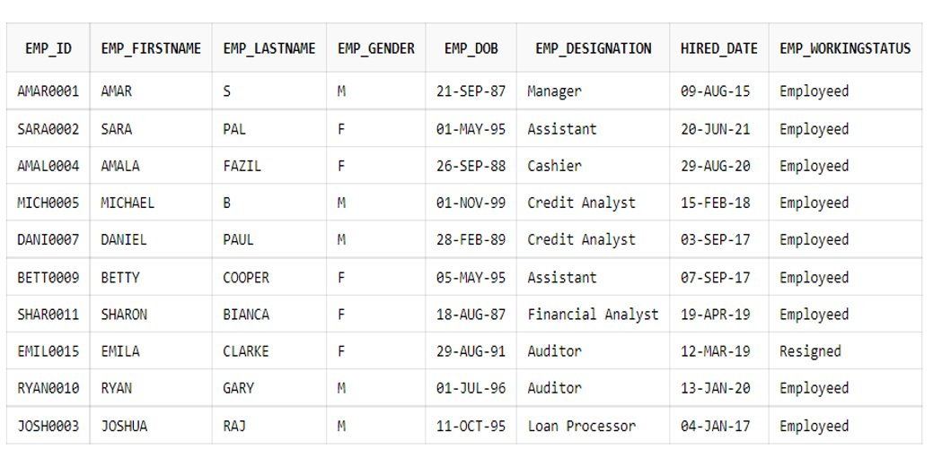
ADMINISTRATOR TABLE Create TABLE ADMINISTRATOR (Emp_id varchar(10) PRIMARY KEY, Emp_firstName varchar(30), Emp_lastName varchar(30), Emp_Gender char(1), Emp_DOB date, Emp_Designation varchar2(20),Hired_date date, Emp_workingStatus varchar2(20));

Slide 23
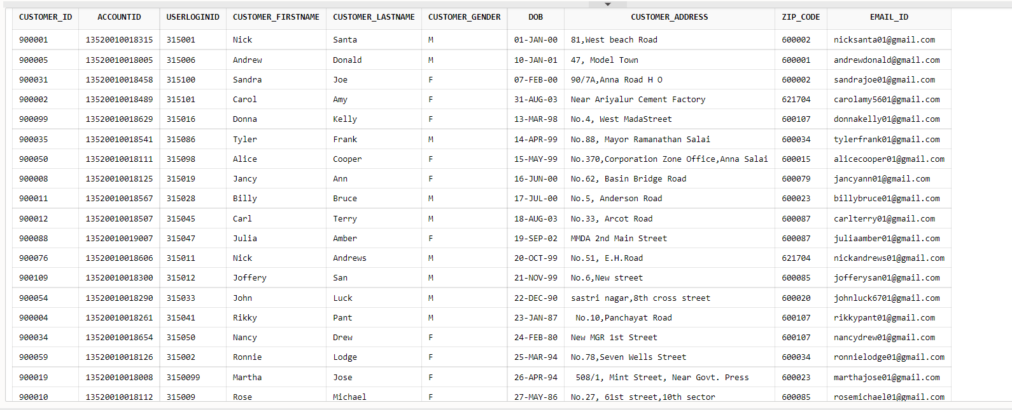
CUSTOMER TABLE Create Table CUSTOMER (Customer_id int PRIMARY KEY, AccountID varchar(20), UserLoginID int, Customer_firstName varchar(30), Customer_lastName varchar(30), Customer_Gender char(1), DOB date , Customer_Address varchar2(100), Zip_code int, Email_Id varchar(30));

Slide 24
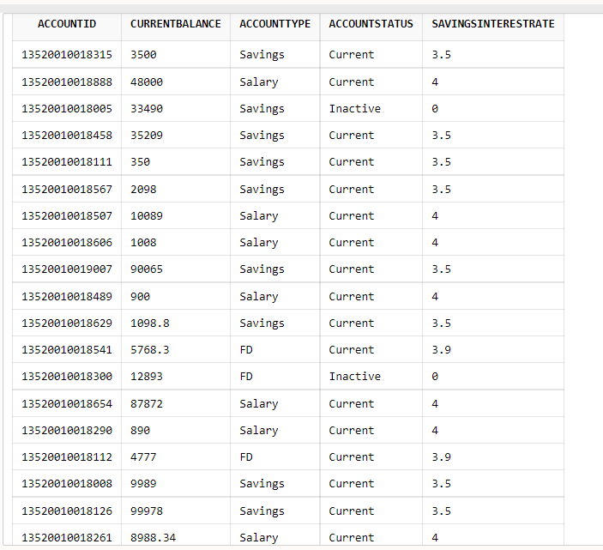
ACCOUNT_DETAILS Create table ACCOUNT_DETAILS (AccountID varchar(20) PRIMARY KEY, CurrentBalance float, AccountType varchar2(20), AccountStatus varchar2(20), SavingsInterestRate float);

Slide 25
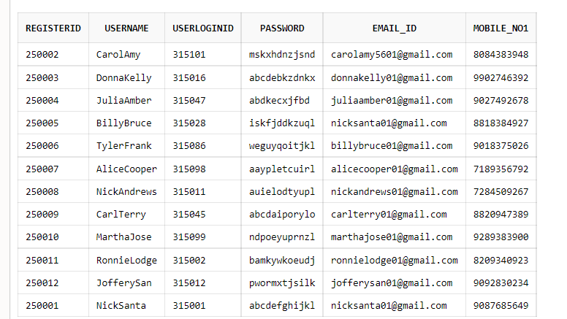
REGISTRATION Create table REGISTRATION (RegisterID int PRIMARY KEY, UserName varchar(20), UserLoginID int, Password varchar(12), Email_Id varchar(30), Mobile_no1 number(10));

Slide 26
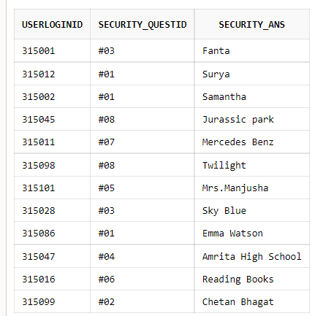
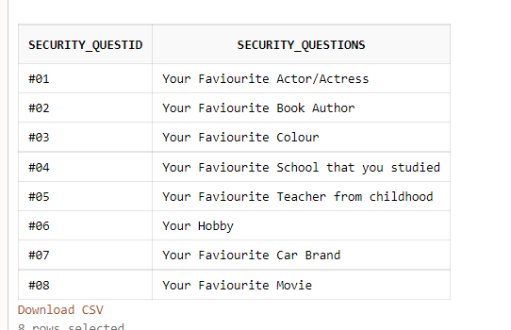
SECURITY QUESTION AND ANSWER Create Table SECURITY_ANSS (UserLoginID int PRIMARY KEY, Security_QuestID varchar(3), Security_Ans varchar(20)); Create Table SECURITY_QUEST (Security_QuestID varchar(3) PRIMARY KEY, Security_Questions varchar(50));

Slide 27
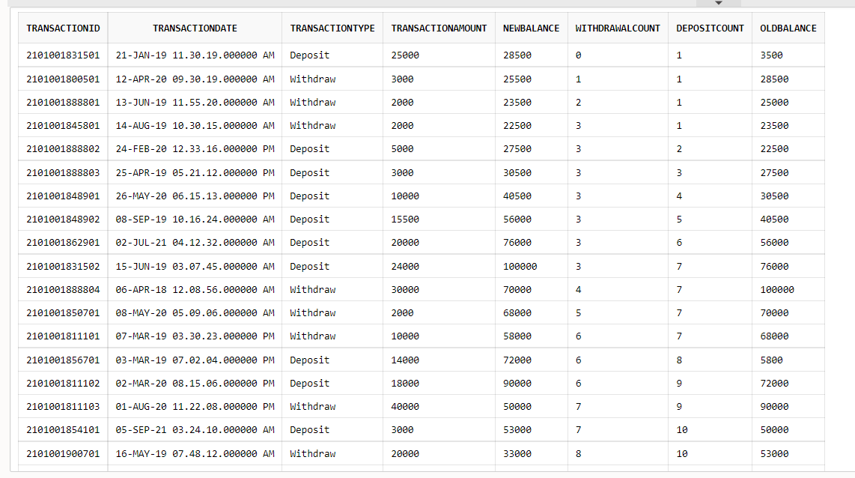
TRANSACTION Create table TRANSACTION (TransactionID varchar(15) PRIMARY KEY, TransactionDate date, TransactionTime timestamp, TransactionType varchar2(20), TransactionAmount float, NewBalance float, WithdrawalCount int, DepositCount int, OldBalance float);

Slide 28
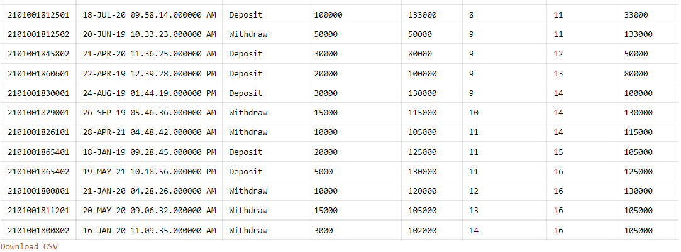
CONDT....

Slide 29
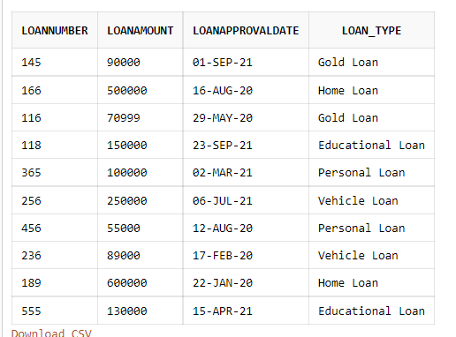
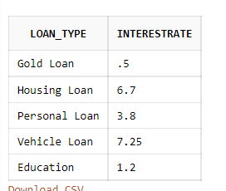
LOANTYPE AND LOAN_DETAILS Create table LOANTYPE (Loan_Type varchar2(20) PRIMARY KEY, InterestRate float); Create table LOAN_DETAILS (LoanNumber int PRIMARY KEY, LoanAmount float, LoanApprovalDate date, Loan_Type varchar2(20)) ;

Slide 30
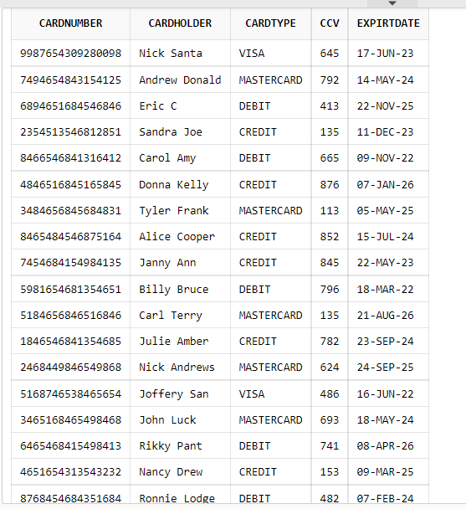
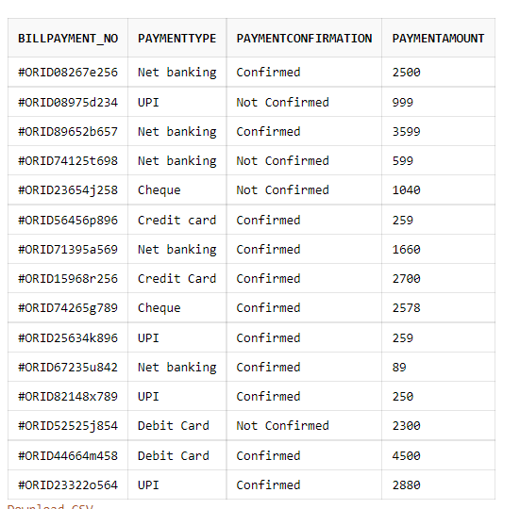
CARD_DETAILS AND BILL_PAYMENTS Create table CARD_DETAILS (CardNumber varchar(16) PRIMARY KEY, CardHolder varchar2(20), CardType varchar(20), CCV number(3), ExpirtDate date) ; Create table BILL_PAYMENTS (BillPayment_no varchar(20) PRIMARY KEY, PaymentType varchar(30),PaymentConfirmation varchar(15), PaymentAmount float);

Slide 31
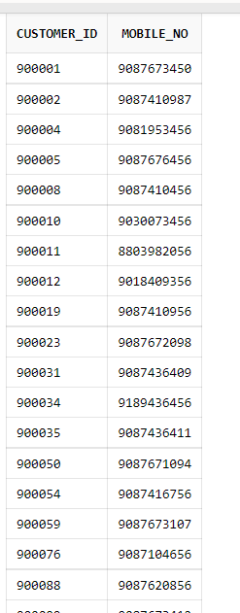
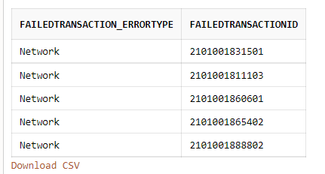
FAILEDTRANSACTIONLOG AND CUS_MOBILE Create table FailedTransactionLog (FailedTransaction_errorType varchar(30), FailedTransactionID varchar(15) PRIMARY KEY) ; Create table Cus_Mobile (Customer_id int, Mobile_no number(10),PRIMARY KEY (Customer_id,Mobile_no));

Slide 32
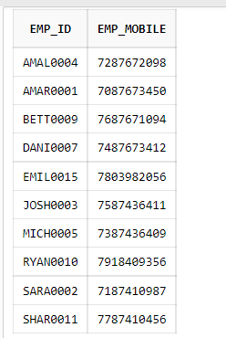
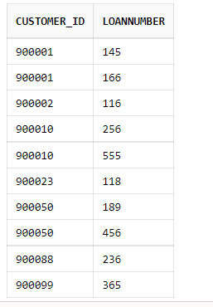
EMP_NUMBER AND LOAN_CUSTOMER Create table Emp_Mob(Emp_id varchar(10), Emp_Mobile number(10),PRIMARY KEY (Emp_id, Emp_Mobile) ); Create table Loan_num(Customer_id int, LoanNumber int,PRIMARY KEY (Customer_id,LoanNumber));

Slide 33
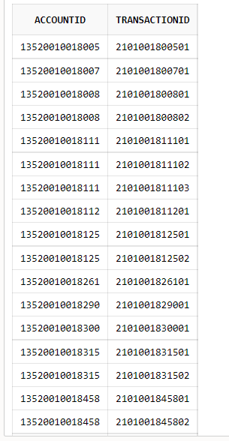
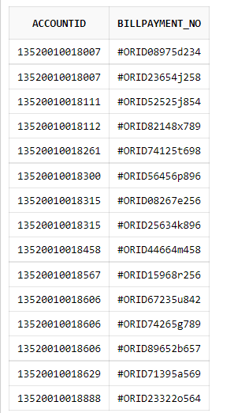
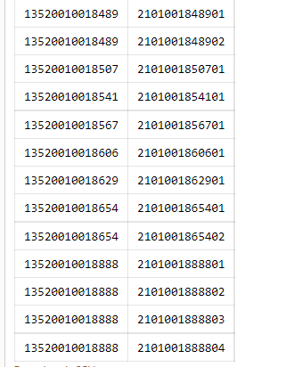
TRANSACT AND BILL Create table Transact (AccountID varchar(20), TransactionID varchar(15), PRIMARY KEY (AccountID,TransactionID)); Create table Bill (AccountID varchar(20), Billpayment_no varchar(20), PRIMARY KEY (AccountID,Billpayment_no));

Slide 34
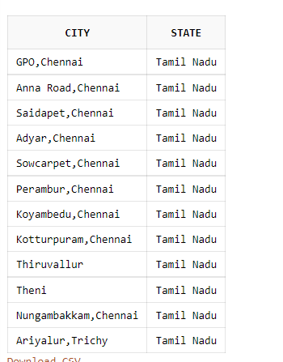
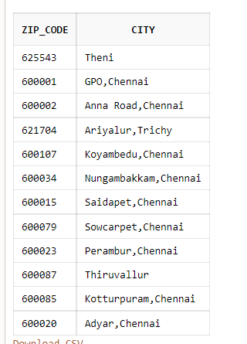
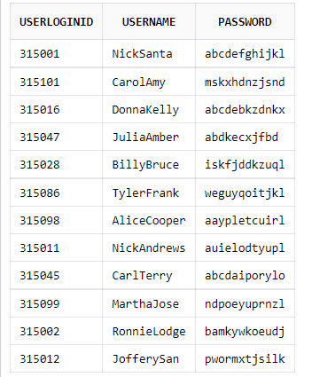
STATE_CITY , ZIP AND USERLOGINS Create Table State_city(City varchar2(20),State varchar2(20)); Create table Zip (Zip_code int, City varchar2(20)); Create Table USERLOGINS (UserLoginID int PRIMARY KEY, UserName varchar(20), password varchar(12));

Slide 35
USER INTERFACE

Slide 36
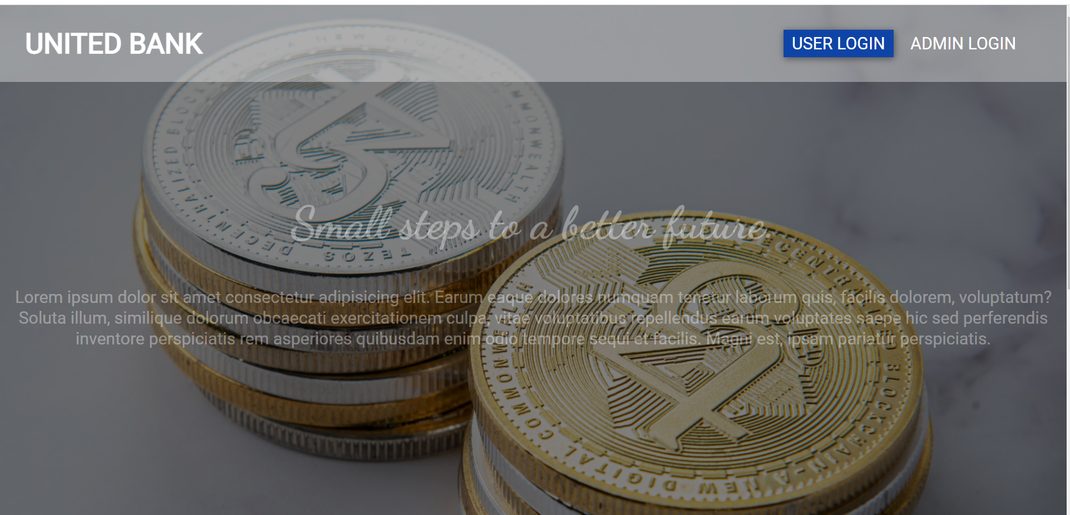
SCREEN 1

Slide 37
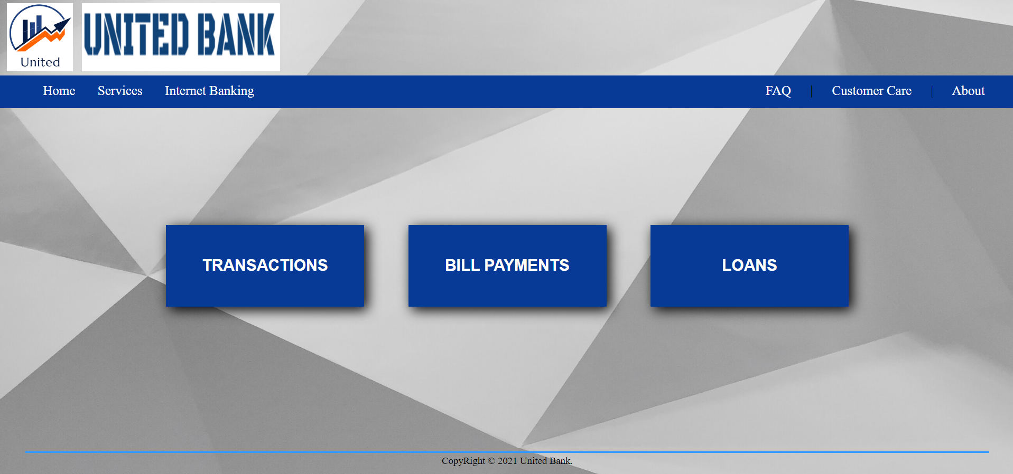
HomePage

Slide 38
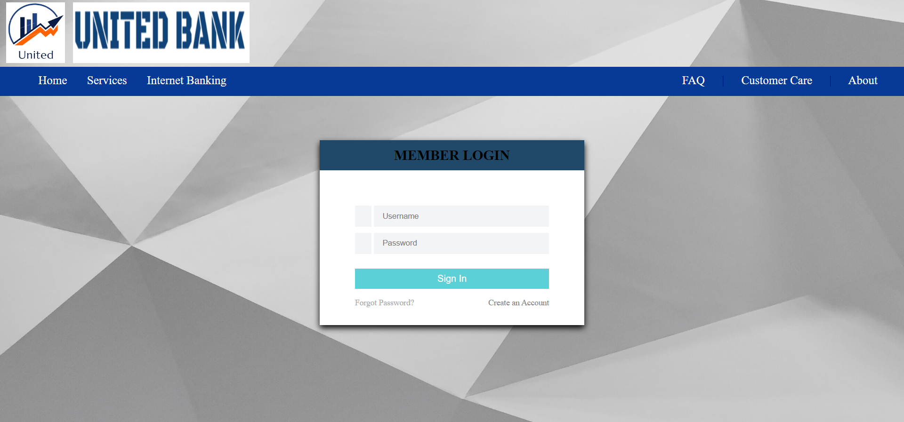
Admin Login

Slide 39
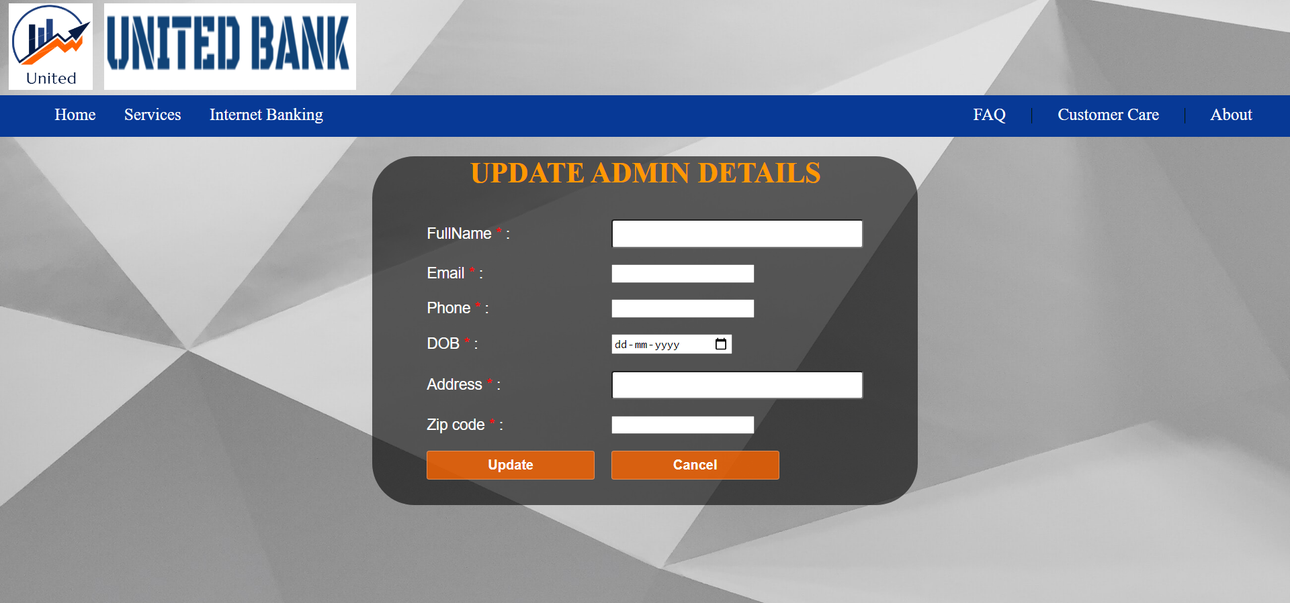
Admin Details Updation

Slide 40
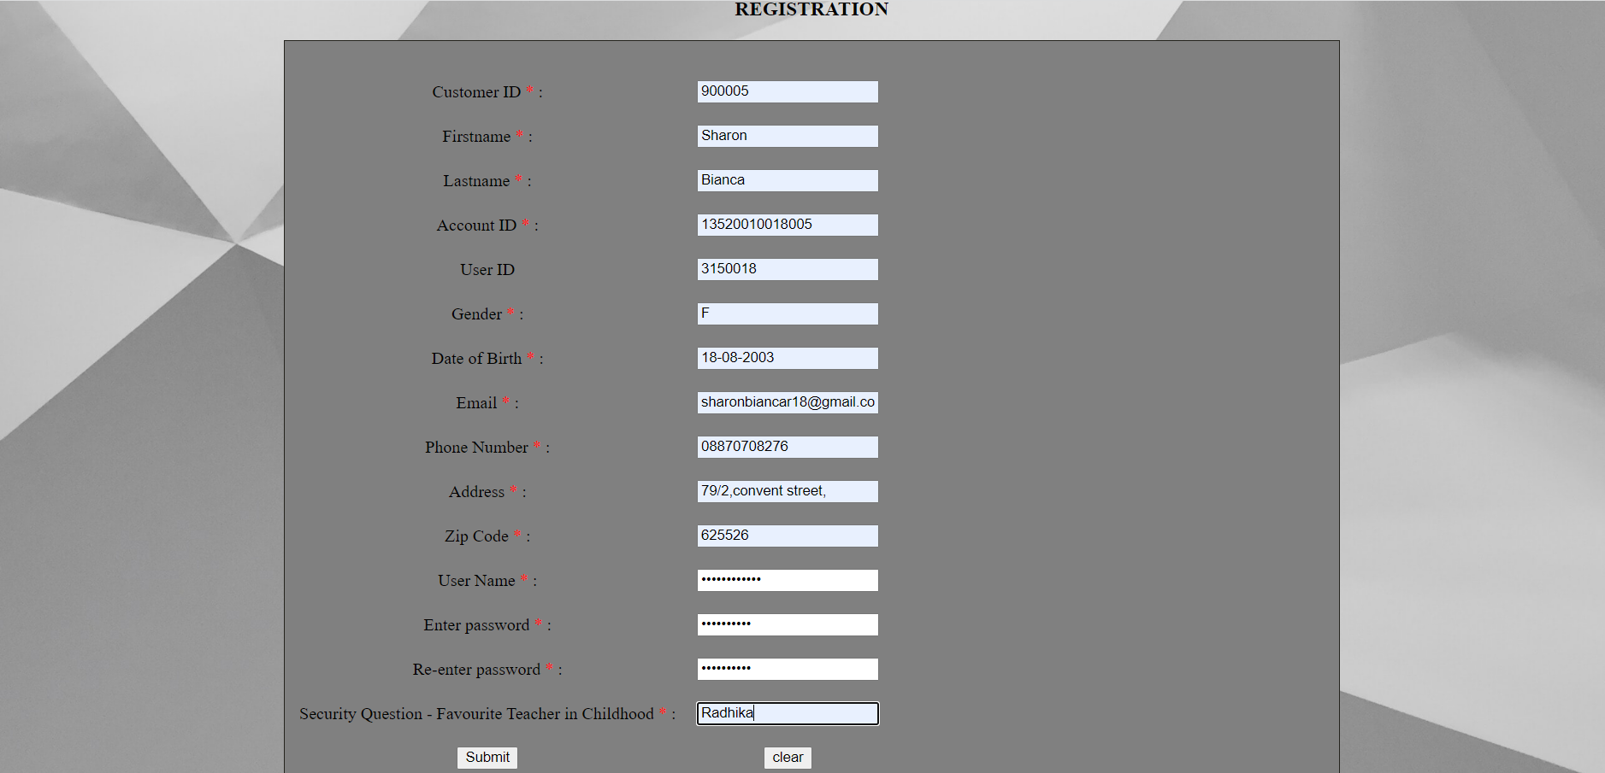
Registration

Slide 41
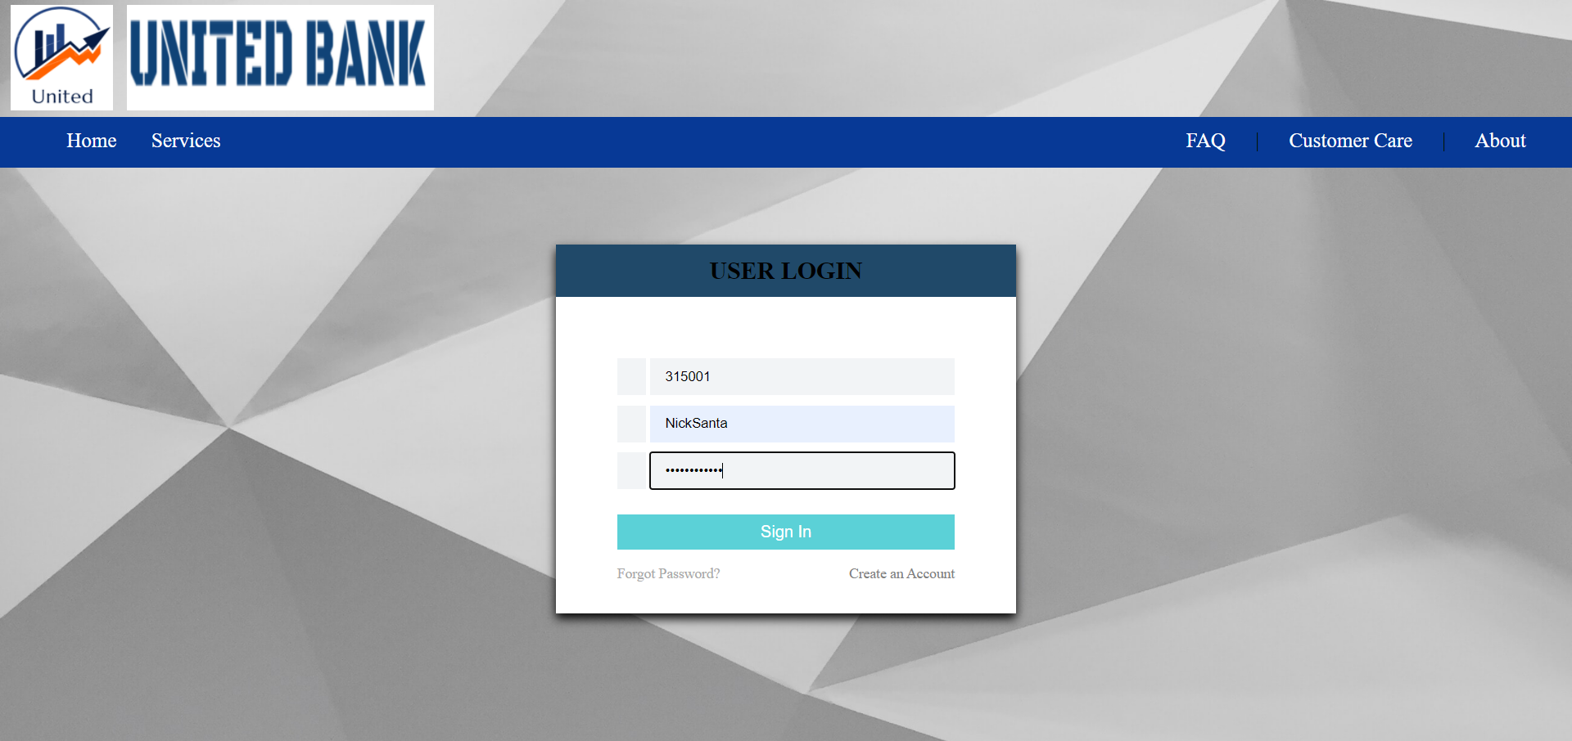
User Login

Slide 42
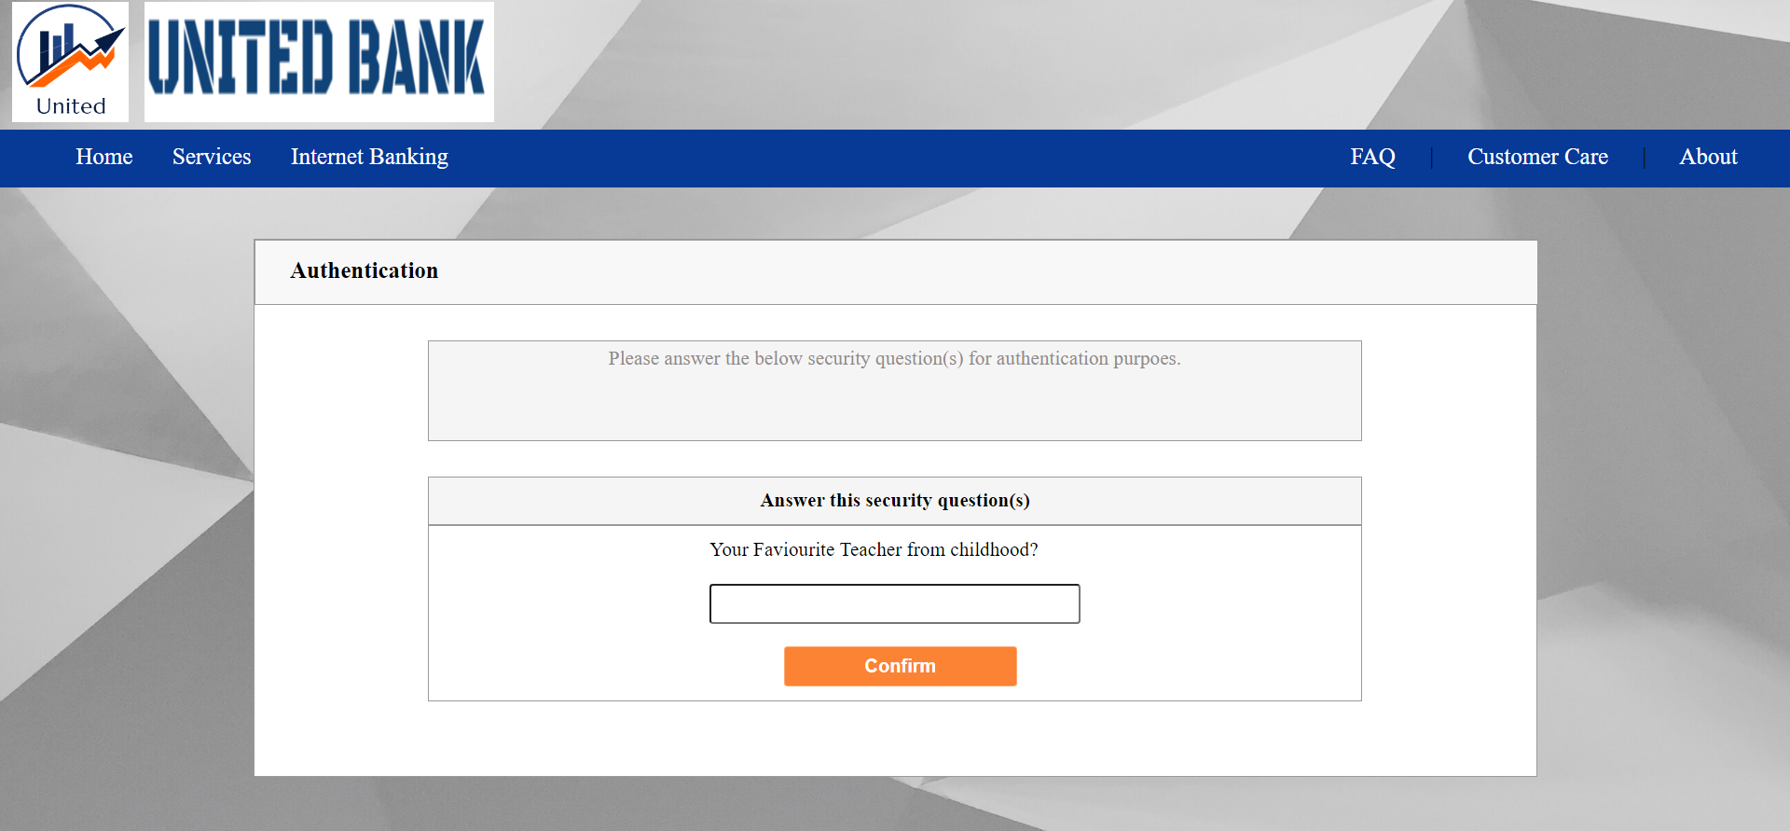
Security Check

Slide 43
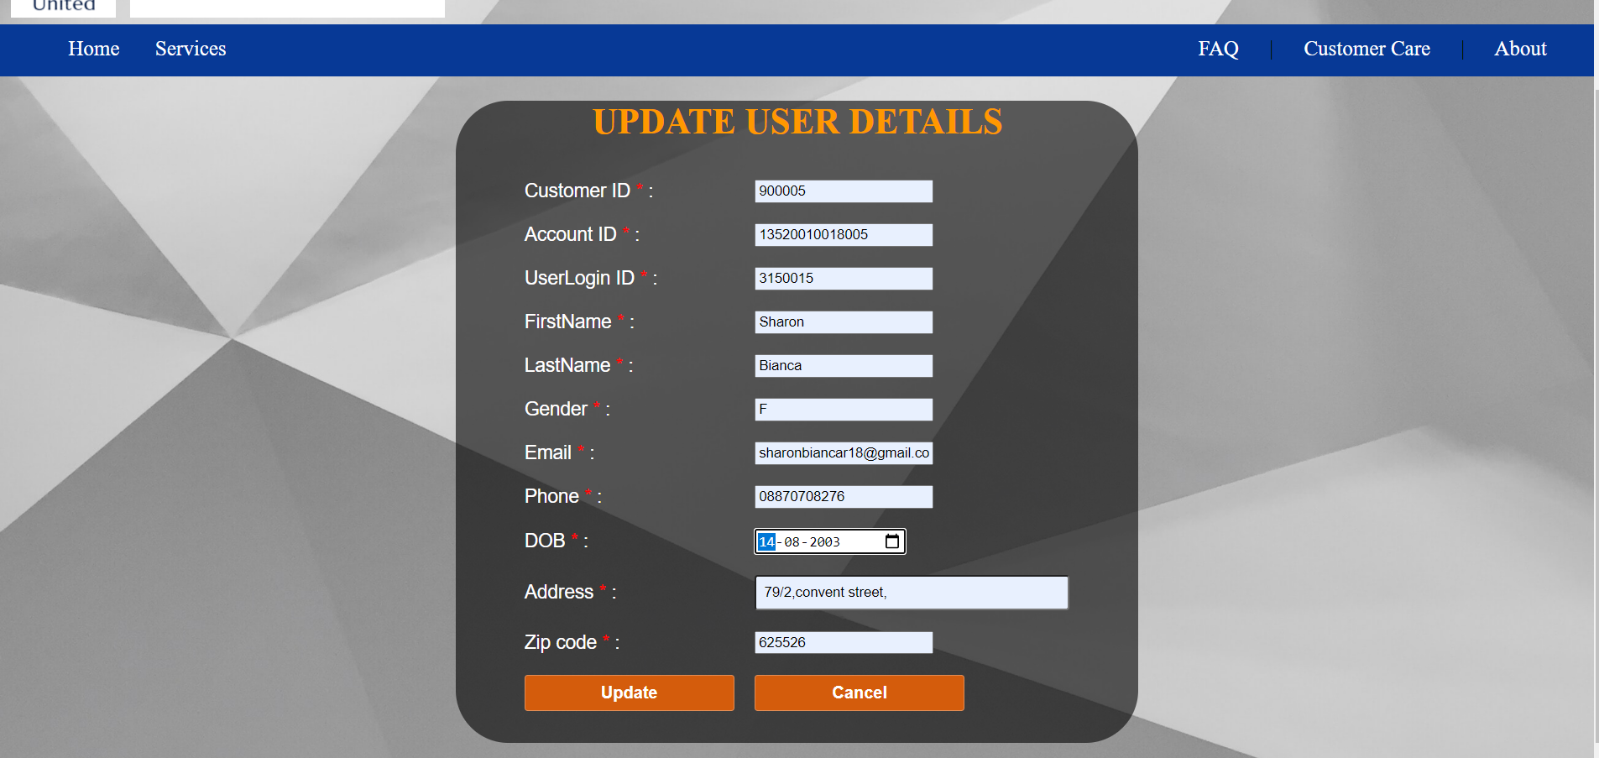
User Details Updation

Slide 44
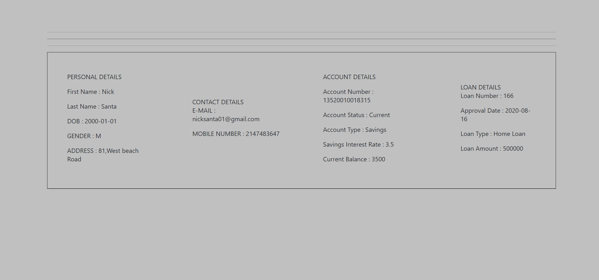
Sample User (DETAILS TABLE PRINTED FROM DATABASE)

Slide 45
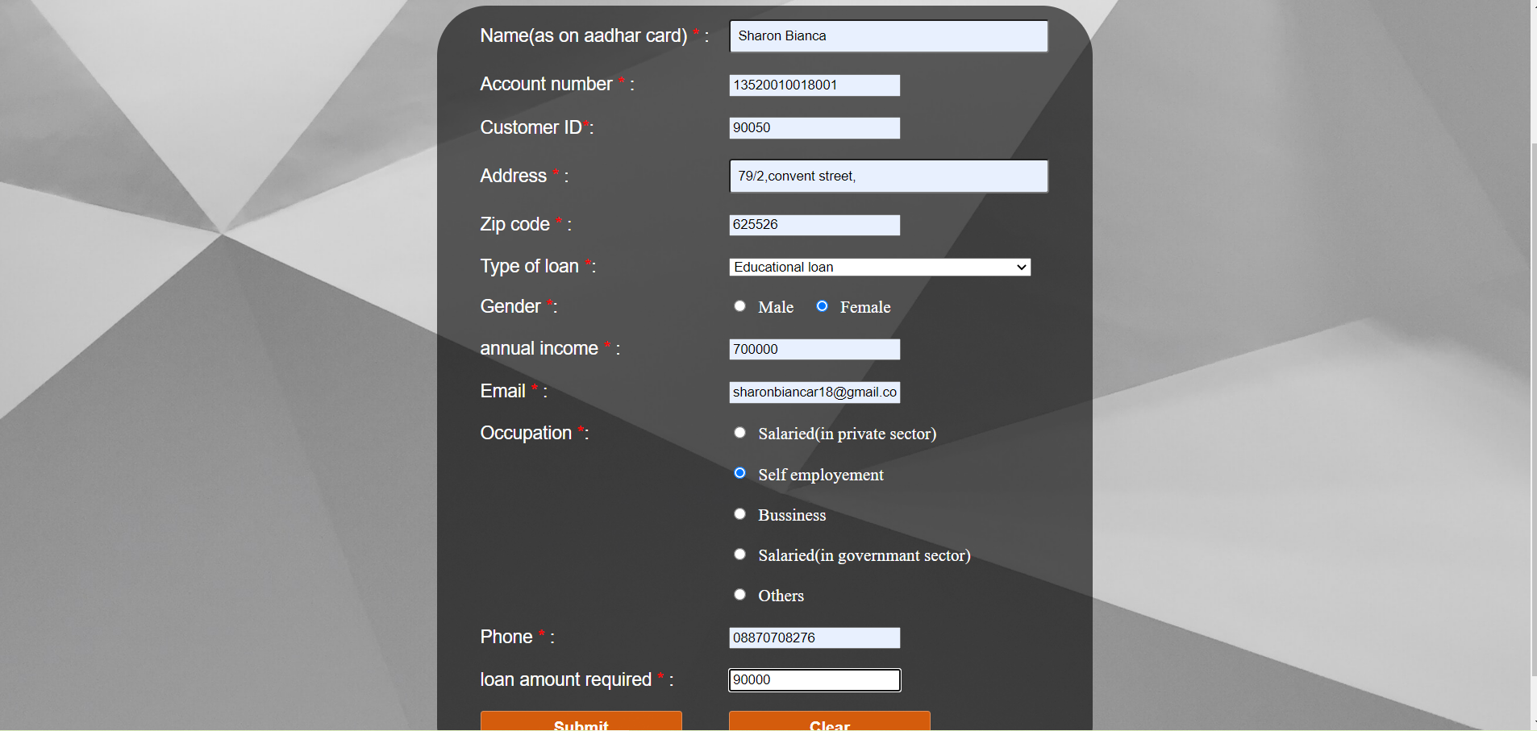
Loan Form

Slide 46
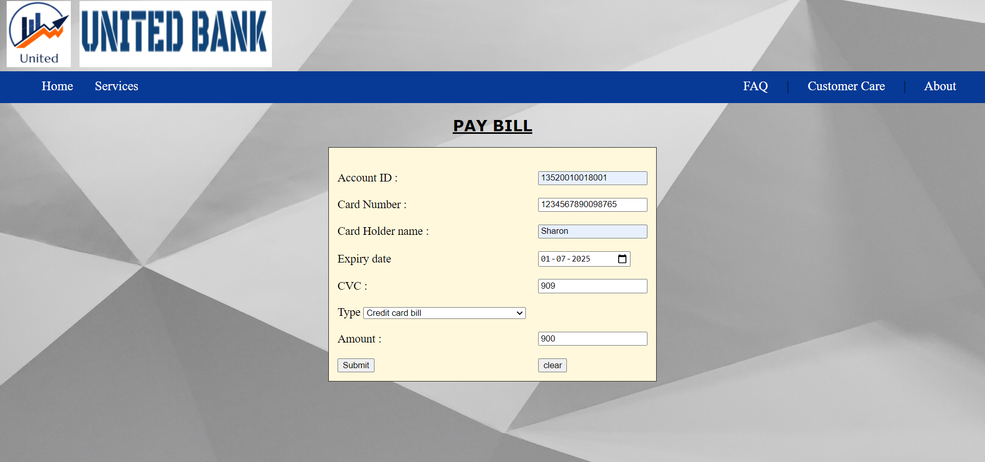
Bill Payment

Slide 47
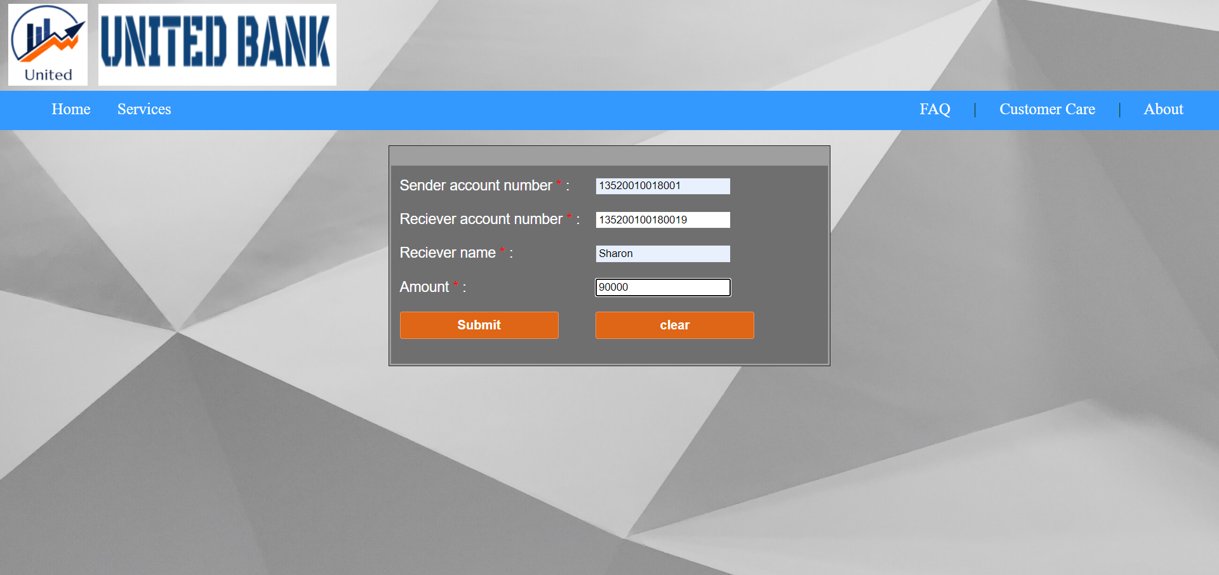
Fund Transfer

Slide 48
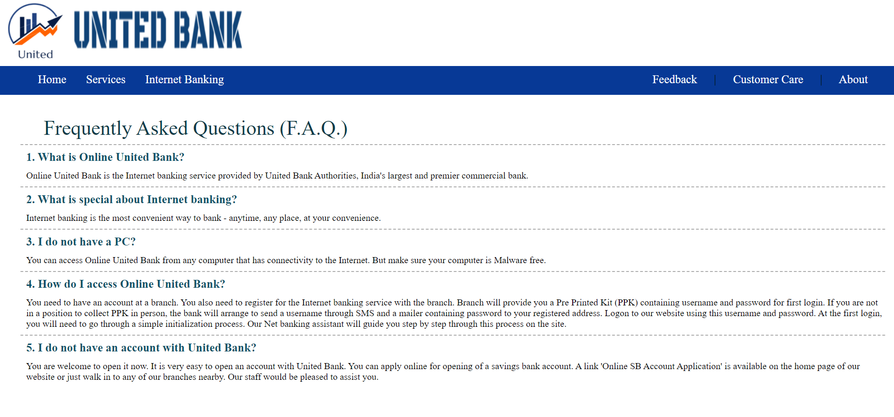
FAQ

Slide 49
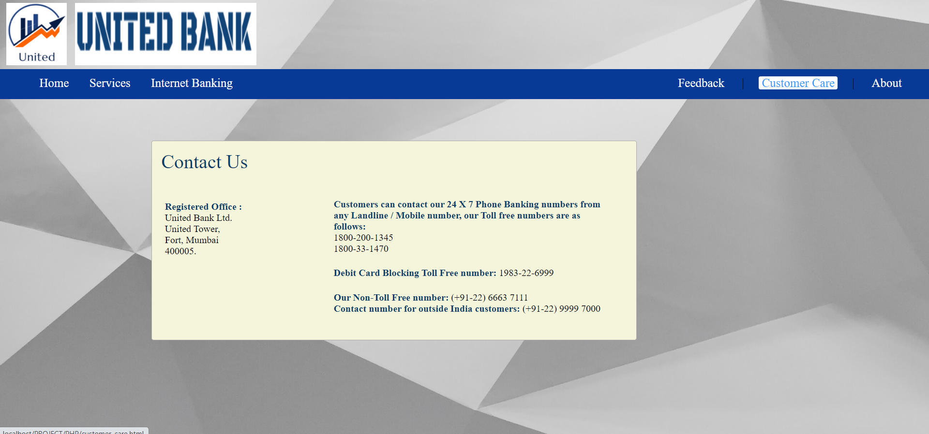
Customer Care

Slide 50
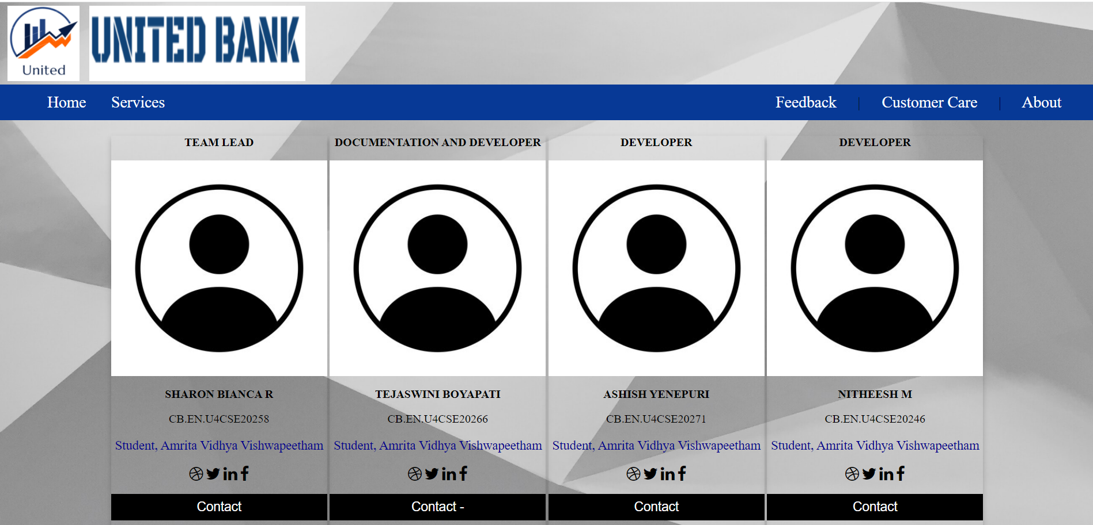
About Us

Slide 51
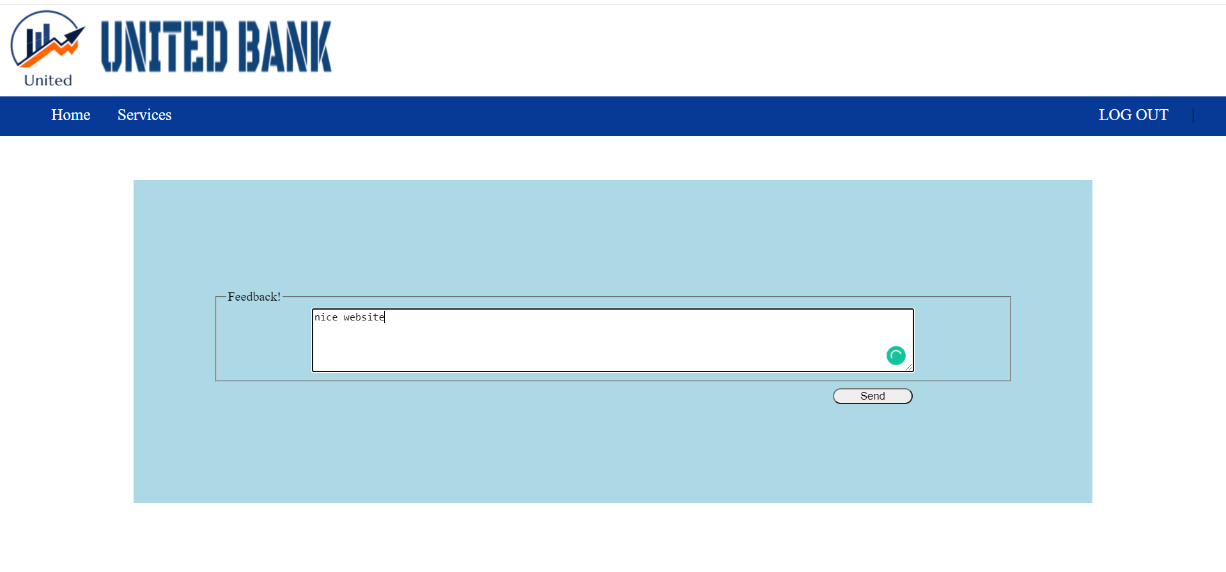
Feedback Form

Slide 52
CONECTIVITY (DEMO) (Frontend and Backend)

Slide 53
CONCLUSION
In order to deal with the banking tasks online, a database to record all the details is very much needed along with a user interface for both the ends to interact. This platform is designed to serve as a one-stop solution for both the customers and administrators.
The main aim of this project is to design and develop a database for the bank to maintain records of various branches of the bank across the country, administrators’ details as well customers' account details, account statements, transaction details, loan details (if availed by the customer) and bill payments in order to nurture the needs of an end banking user by providing various ways to perform banking tasks online.
→→ Elucidating important features of the project:
• Interface creation for Online banking system.
• Register/Log-in by customers to access their bank accounts (savings or current or both)
• Maintaining records of deposition, transactions by customers and customer details.
• Issuing receipts, OTP(s) and mails for transactions.
• Maintaining records of administrators’ details.
• Maintaining records of loans availed to customers.
• Debit/Credit card services
• Maintaining records of bill payments (electricity bills, water bills, municipal bills, credit/debit card bills, etc.)
• Report generation

Slide 54
TEAM MEMBERS
S.NO | NAME | ROLL NUMBER
1 | SHARON BIANCA R | CB.EN.U4CSE20258
2 | TEJASWINI BOYAPATI | CB.EN.U4CSE20266
3 | ASHISH YENEPURI | CB.EN.U4CSE20271
4 | NITHEESH M | CB.EN.U4CSE20244

Slide 55

THANK YOU

